Slide 1
Database Design Fundamentals
DV6E 34

Slide 2
Topics/Outline
Database – Definition, Types, Terminologies, concepts, classes & examples
Flat Files
Relational Database Management System (RDBMS)
E-R Model Systems
Normalisation
SQL – Introduction, queries,
Creating Database (simple - excel & structured - RDMS)
Basic Operations (DB interrogation, data acquisition, modification, normalisation, manipulation….)

Slide 3
Summary Outcomes of The Unit
Database (DB) Introduction
Definition
Types
Concepts
Examples…
Structured Query Language (SQL)
Definition
Concepts
Examples
Create/design RDBMS
Relational Database Management System
Maintain database
Perform basic operations
DB interrogation
Data search
Data retrieval/acquisition
Data manipulation
…….

Slide 4
Unit Outcomes, Knowledge & Requirements
Unit Outcomes | Knowledge/Skills | Requirements
1 (Create normalised RDMS structure) | Develop a relational database model to agreed organisational standard | Successfully normalise data to the required standard Construct a data model derived from 3NF relations Produce a data dictionary for the entities created
2 (Write SQL statements to maintain and update a database structure) | Populate tables with records Update tables according to user requirements Create constraints and primary keys within tables. | Populate the tables with records conforming to the data dictionary created in Outcome.1 Search, interrogate and modify the tables according to user requirements
3 (To interrogate the database created and manipulate the data) | Use SQL to create queries to meet user requirements Sorting, updating and deleting data records to meet user requirements Incorporate calculations within queries | Create queries that ‘join’ more than one table in a select statement Produce formatted query responses

Slide 5
Part. A: Introduction To Database (DB)

Slide 6
Introduction
Data: known facts that can be recorded
Database: a collection of data
represents some aspect of the real world
logically coherent collection (not a random collection)
designed, built & populated for a specific purpose
Database Management System: the tool (i.e. software) that manages the data operation.

Slide 7
What Are Databases (DB)?
A DB may be defined as a collection of data organised into a structured format.
A database is a structured collection of records.
Database consists of columns (attributes) and rows (records).
The word ‘Database’ is often linked to data held on a computer
A database is a persistent, logically coherent collection of inherently meaningful data, relevant to some aspects of the real world.
Surname: James
First name: Samantha
Date of Birth: 20.12.89
Address: 16 Poppy Close
Town: Southam
County: Warwickshire
Surname: Brown
First name: David
Date of Birth: 20.12.89
Address: 16 Poppy Close
Town: Southam
County: Warwickshire
Surname: Lastler
First name: David
Date of Birth: 20.12.89
Address: 16 Poppy Close
Town: Southam
County: Warwickshire
Surname: Whitefield
First name: Nina
Date of Birth: 21.02.76
Address: 16 Poppy Close
Town: Southam
County: Warwickshire

Slide 8
Data vs. Information
Data are raw facts
Information: Is the result of processing raw data to reveal meaning
Information requires context to reveal meaning
Raw data must be formatted for storage, processing, and presentation
Data are the foundation of information, which is the bedrock of knowledge
Data: Building blocks of information
Information produced by processing data
Information used to reveal meaning in data
Accurate, relevant, timely information is the key to good decision making
Good decision making is the key to organizational survival

Slide 9
Forms of Databases (DB)
Database format can either be:
Paper-based
Computer-based
Examples of Paper Based DB
Telephone directory
Address book
Card index system
Details of car repairs
Customer returns book
Examples of Computer Based DB
Data tables
Files
NHS registered DB of patient’s medical histories
Police records of crimes in a locality
Note:
Main difference between paper and computerised database is the speed by which data can be accessed, retrieved and formatted.

Slide 10
Types of Database
Flat-file
Hierarchical
Network
Relational
Object-oriented
Object-relational

Slide 11
Types of Database – Contd.
Databases can also be classified according to:
Number of users
Database location(s)
Expected type and extent of use
Single-user Database: Supports only one user at a time
Desktop database: single-user; runs on PC
Multi-user Database: Supports multiple users at the same time
Workgroup and enterprise databases
Centralized database: Database located at a single site
Distributed database: Database distributed across different sites/locations
Operational database: Supports a company’s day-to-day operations
Transactional or production database
Data warehouse: Stores data used for tactical or strategic decisions

Slide 12
Database Organization
Tables
Fields (Columns)
Has many types
Primary Key (Optional)
Records (Rows, Entries)

Slide 13
Types of Data
Alphanumeric (Text, Memo)
Numeric (Number, Currency, etc.)
Date/Time
Boolean (Yes/No)

Slide 14
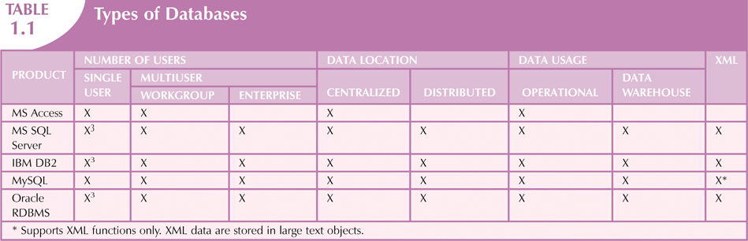
Types of Data – Contd.
Unstructured Data: Exist in their original state
Structured Data: Results from formatting
Structure applied based on type of processing to be performed
Semi-structured Data: Have been processed to some extent
Extensible Markup Language (XML): Represents data elements in textual format
XML database supports semi-structured XML data

Slide 15
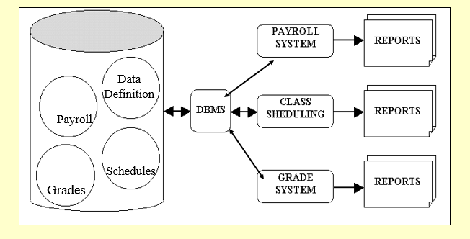
Database (DB) Systems

Slide 16
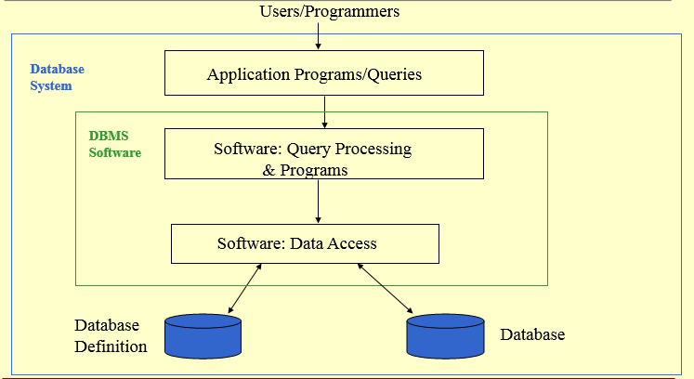
Database (DB) Systems Environment

Slide 17
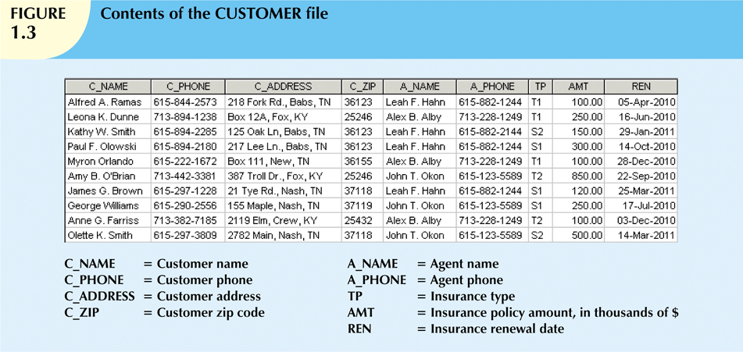
Database (DB) Systems

Slide 18
Database Concepts
Keys
Attribute
Record
Table
* Class Exercise: Describe each of the DB concept above and give relevant examples of each

Slide 19
Database – Data Files Format
Text Files (.txt)
Word Files (.doc)
Excel Files (.xls)
Access Files (.mdb)
Refer to class exercise on following slide.

Slide 20
Database – Data Files Format – Tutorial 1
Part A.
Put together a DB consisting lists of countries in S.America. The DB should consist of the following information;
S/N
Country Name
Population
Dialing Code
Part B.
Setup your DB using the following file extensions
*.doc
*.xls
*.txt
*.csv
Part C.
After completing the task, you are expected to advice a client (A Big Engineering Firm) who plan to setup a DB to store data with file size ~ 100TB. Your advice should address the following question
Which format to recommend for the company in order to minimize their spend
What logical reason will you give to support your choice of file format to use?

Slide 21
Resource - Links
https://www.sqa.org.uk/e-learning/DDFun01CD/index.htm

